Slide 1
Notes:
Power Point was developed by CHANGE Illinois.

Slide 2
Notes:
Redistricting done following Decennial Census. Last Census 2010. Lines for Congressional and State Legislative Districts Drawn in 2011 for 2012 Elections

Slide 3
Notes:
1960s US Supreme Court Rulings Baker v Carr and Reynolds v Sims ruled that each person should have only one vote.

Slide 4
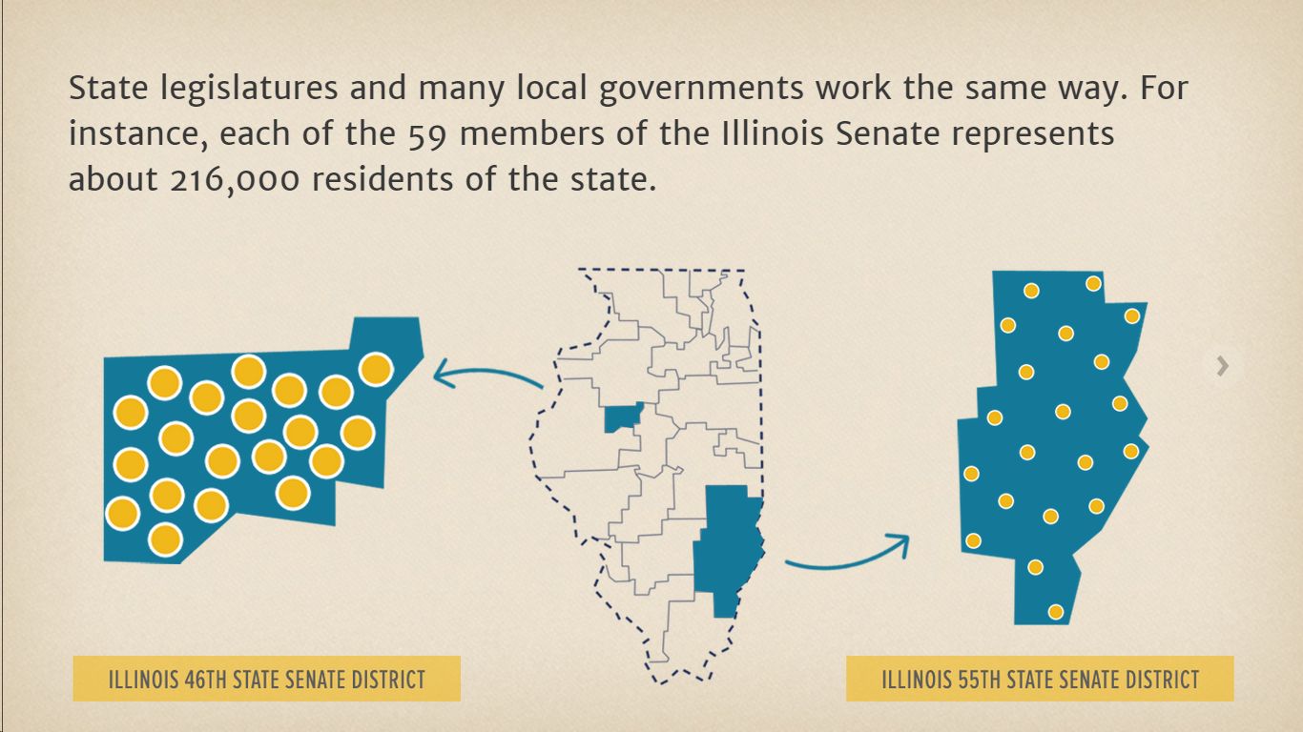
Notes:
Districts are required to be drawn to be compact and contiguous and to have substantially equal populations numbers. Il House Members Represent 108,000 residents. IL 46th – David Koehler – Peoria,
IL 55th – Dale

Slide 5
Notes:
The lines determine the districts in which voters cast their votes.

Slide 7
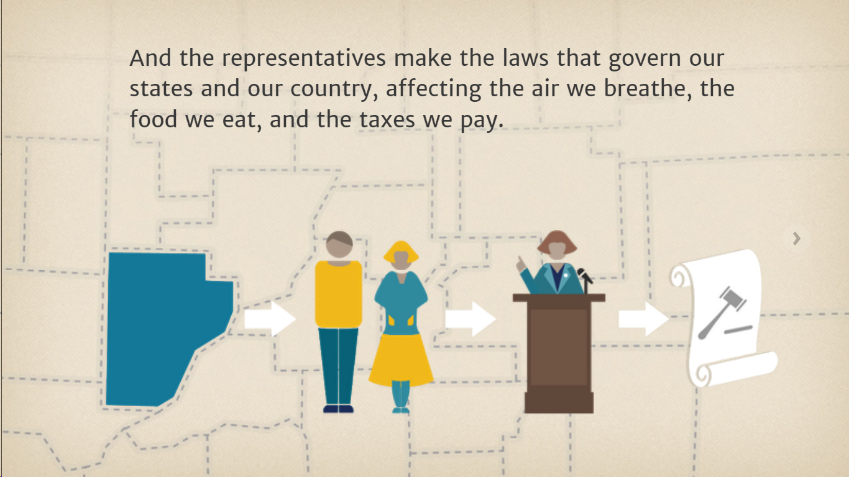

Slide 8
Notes:
In Illinois the state legislature subject to approval by the governor has first crack at drawing the maps.

Slide 9
Notes:
The 4 legislative leaders each appoint 2 members, one legislator and one person who is not a member of the IL General Assembly.

Slide 11
Notes:
In Illinois the political party that has their commissioners’ name drawn gets control of drawing the state legislative maps.

Slide 12
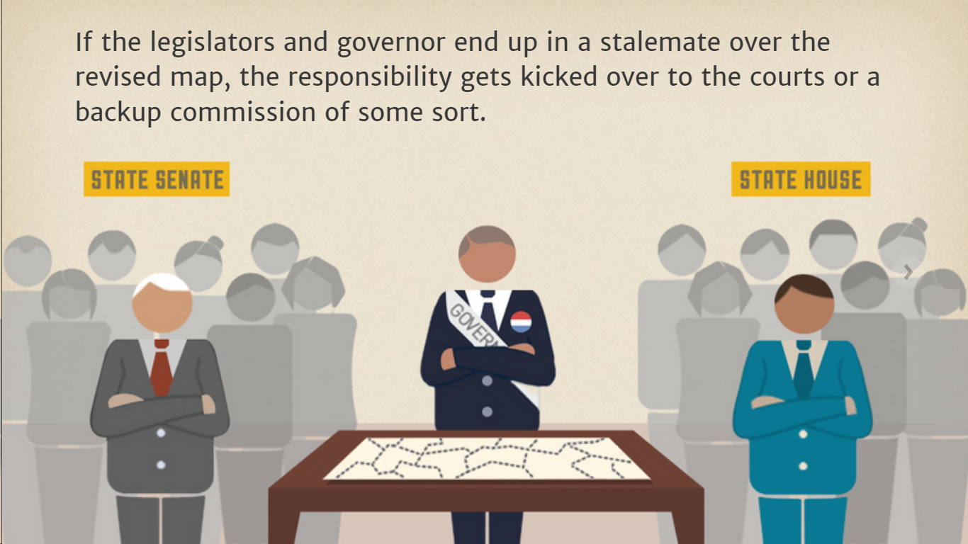

Slide 13
Redistricting
The Good, The Bad and The Ugly

Slide 14
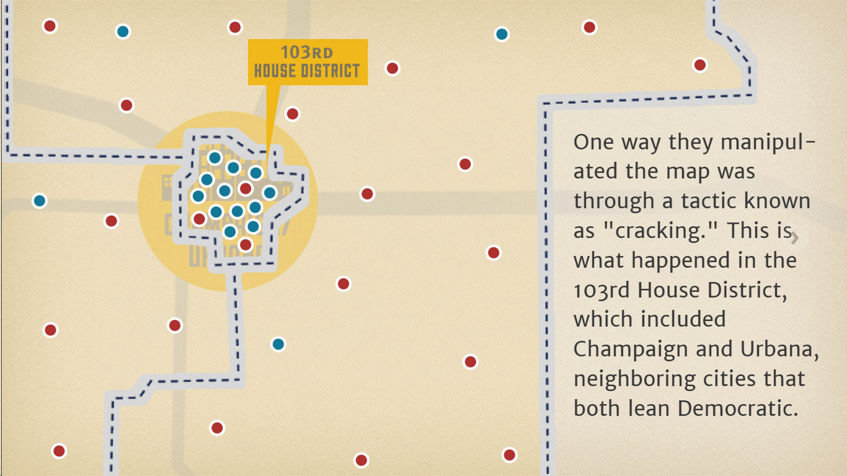
Notes:
103rd Representative District 1982

Slide 15
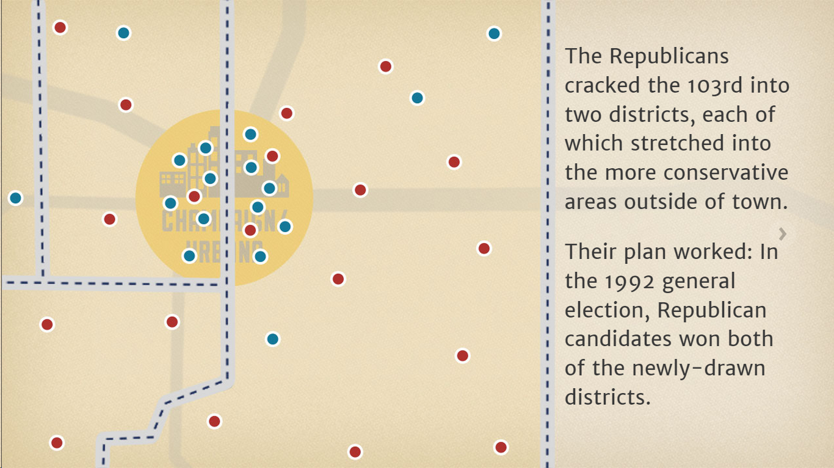
Notes:
103rd Representative District 1992

Slide 16
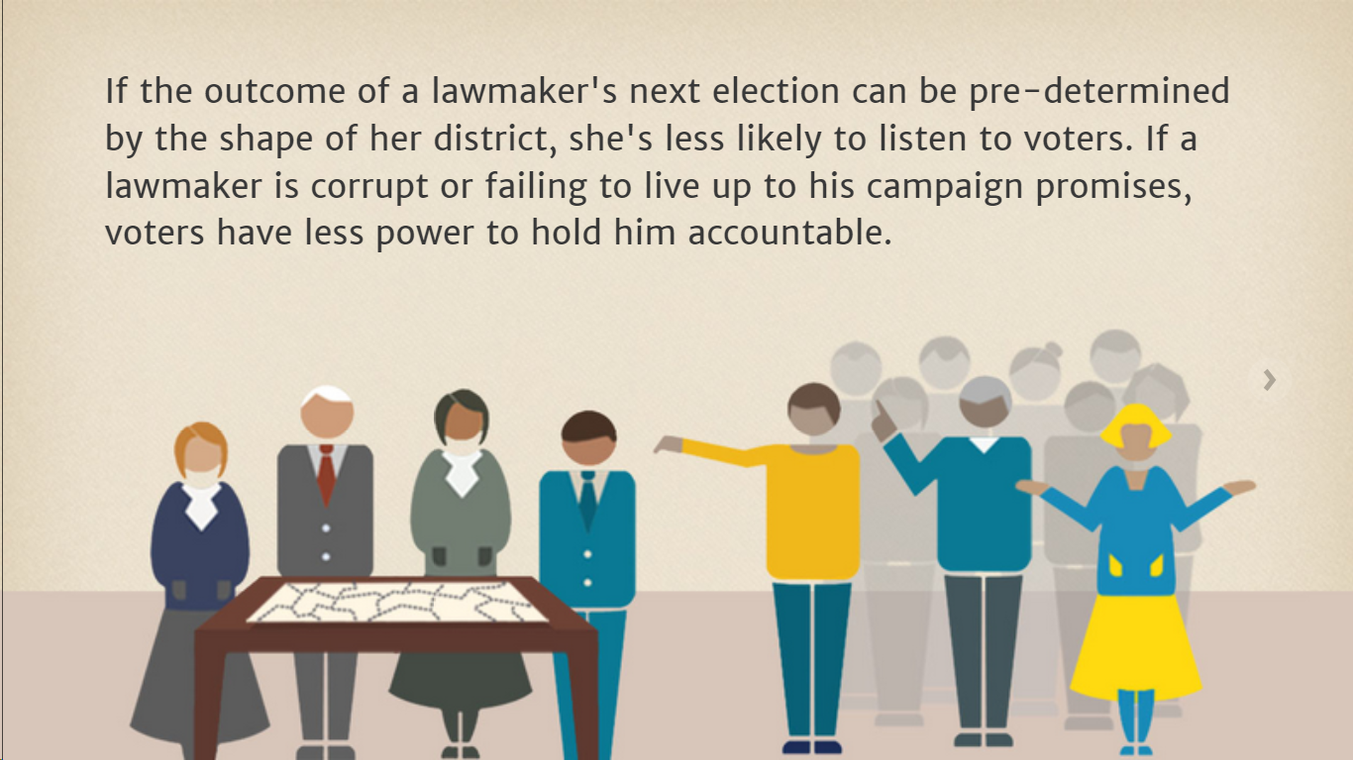

Slide 18
Notes:
2001 Map

Slide 19
Who draws the maps in Illinois?
Illinois has some of the most gerrymandered districts in America. Politico said that Speaker Madigan “punched his ticket to the partisan hall of fame” with the 2011 mapping process.
Party leaders drew the maps entirely behind closed doors. They packed citizens into districts that punished political foes and rewarded allies in their party—just as Republicans have when they controlled the process. Along the way, communities of color were cracked into pieces, diluting their voting power. They also split towns and neighborhoods throughout the state, and disenfranchised others.

Slide 20
1. Creating Apparatchik Legislators
The new map splits Springfield in three, and connects it with rural areas and Decatur to form the 96th district. Under the new map, Springfield residents cannot hold a single representative accountable, and voters in the rural areas are essentially disenfranchised.
The majority party and its allies spend $88,000 to help a political neophyte win the primary on the strength of brutal attacks-by-mail against independent-minded competitors. She avoids candidate forums and media questions, but coasts to general election victory.
Notes:
IL State House District Maps can be found at www.elections.il.gov/votinginformation/2011representativedistricts.aspx
Apparatchik – an official or bureaucrat in any organization.
96th Legislative District

Slide 21
2. Avoiding Accountability
A longtime state representative has been in office since 1990. He is a retired City of Chicago Clerk and the brother of a powerful Chicago Alderman. In 2011, he becomes a lobbyist at City Hall but does not step down as an elected official, creating an uproar over conflicts of interest.
During the re-map, the 1st district is drawn tailored to his political base. He runs unopposed in the primary and unopposed in the general election in 2012.
Notes:
This is called Gerrymandering when districts are drawn to the advantage of a particular person or party.

Slide 25
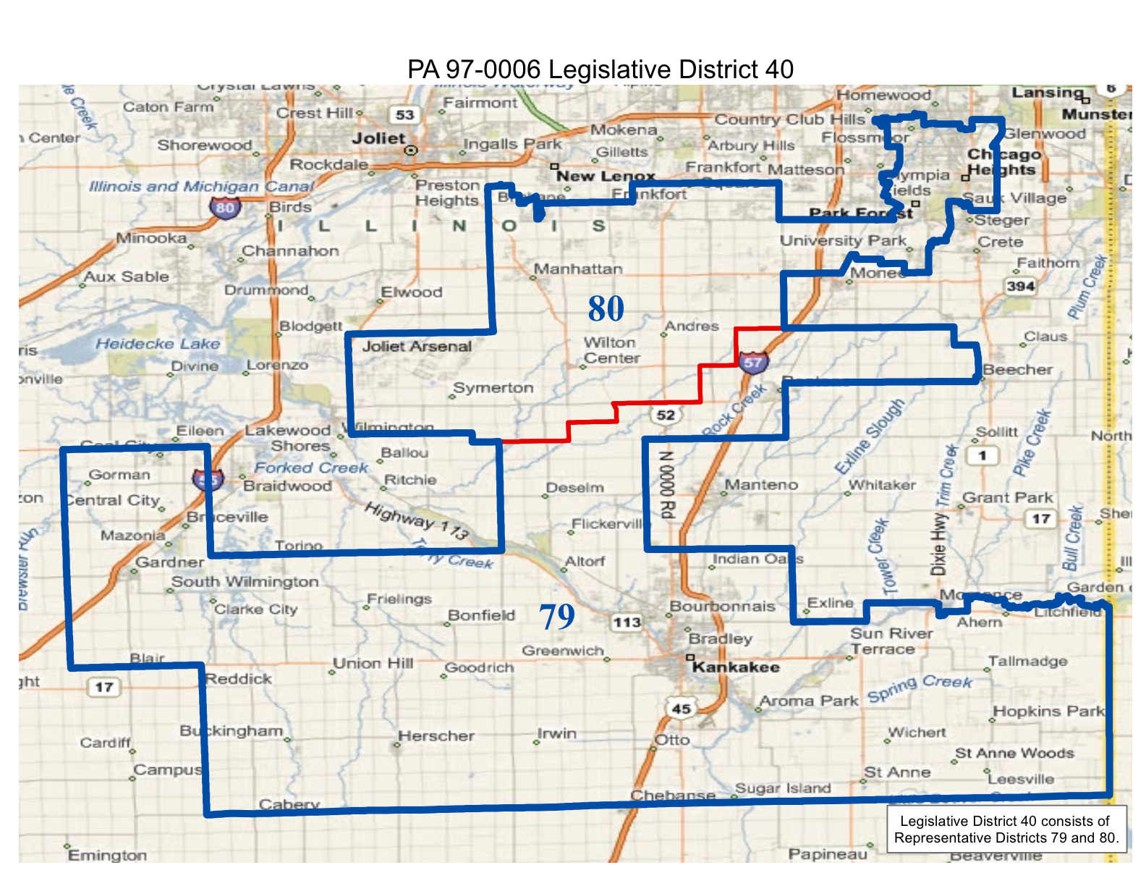

Slide 26
The Last Four Legislative Maps & Electoral Advantage
Election Year | Party Drawing Map* | Seats Gained in House & Senate** | Uncontested House & Senate Races | Competitive House & Senate Races***
1982 | Democrats (tiebreaker) | 13H & 3S | 30 | 28
1992 | Republicans (tiebreaker) | 5H & 4S | 35 | 30
2002 | Democrats (tiebreaker) | 4H & 5S | 77 | 14
2012 | Democrats | 7H & 6S | 101 | 16
*In the event that both the legislature and an independent commission fail to agree on a new map, a 9th commission member is randomly selected from one of the two main parties.
** Seats gained by the party that drew the map in election immediately following the redrawing.
*** Competitive elections are defined as elections in which the losing candidate received at least 45% of the vote.
Notes:
This chart came from the paper Backroom Battles and Partisan Deadlock, Redistricting in Illinois; commissioned by CHANGE IL. The party picks the voters rather than the voters picking their officials.

Slide 27
What does good redistricting look like?
Independent mappers. Distance politicians from the map-drawing process by creating an independent redistricting commission.

Slide 28
Transparent process. Open redistricting to the public, with ample opportunity for citizens to have direct input into the maps before and after they are drafted.

Slide 29
Nonpartisan criteria. While no list is perfect, there is general consensus among scholars and practitioners about districts:
Contiguous, substantially equal in population, in compliance with federal laws
Not drawn to dilute or diminish the ability of a racial or language minority community to elect the candidates of its choice
Respecting the geographic integrity of cities, towns, and other units of local government
Respecting the geographic integrity of communities sharing common social and economic interests
Not drawn to purposefully or significantly discriminate against or favor any political party or group, and not considering the residence of any person

Slide 30
What happens when you do it right
A number of states have instituted independent, nonpartisan redistricting. The results include:
Greater public interest in elections
Increased competition
New candidates entering the process and winning
Greater accountability to voters

Slide 31
Arizona (old map)
Partisan redistricting had created an absurd outcropping in District 2, giving Trent Franks, one of the most conservative members of Congress, a virtual lock on elections in his district from 2002-2010.
Notes:
Arizona Congressional District 2

Slide 32
Arizona (new map)
The independent redistricting commission created a more reasonable, less partisan map in 2011. The outcropping from District 2 disappeared. More competitive districts put a larger number of seats in play. Whereas in 2010, the Republican-Democrat balance was 5 to 3, in 2012 it was 4 to 5 (the state gained one seat due to population growth).
Notes:
June 29, 2015 the United States Supreme Court upheld an Arizona Independent Redistricting Commission in a 5-4 vote. Justice Ruth Bader Ginsburg was joined in the majority opinion by Justices Kennedy, Breyer, Sotomayor, and Kagan.
An article in the New York Times this morning notes, "About a dozen states have experimented with redistricting commissions that have varying degrees of independence from the state legislatures, which ordinarily draw election maps." There continue to be efforts in Illinois to this affect, with many reform groups noting the need for redistricting reform at the state level.
The Supreme Court's Majority Opinion, penned by Justice Ginsburg, states,
"We see no constitutional barrier to a State's empowerment of its people by embracing that form of lawmaking
[in redistricting]." They cited the constitutional reasoning behind their argument, noting, "the Elections Clause [of the United States Constitution]...is not reasonably read to disarm States from adopting modes of legislation that place the lead rein in the people's hands" when it comes to redistricting reform.
The Court majority opinion also made it clear that states with independent commissions have succeeded to a great degree in limiting the conflicts of interest that occur when legislators have control over drawing of legislative district maps. Independent redistricting commissions “impede legislators from choosing their voters instead of facilitating the voters’ choice of their representatives,” according to the opinion. The court said the people of Arizona used the initiative process to curb gerrymandering and restore the core principle of republican government – that voters should choose their representatives, not the other way around.
Today, it’s clear that there is no federal constitutional prohibition on any redistricting commissions.
The petition drive to put the Independent Map Amendment before Illinois voters continues, full speed ahead.

Slide 33
California: The Ribbon of Shame
This is the 23rd District from 2002-2010, called the “ribbon of shame” because it hugged more than 200 miles of coastline. It was created not to represent any community, but to give Democrats a guaranteed seat. (Republicans had a similar district, the 46th, in Orange County.)
Notes:
California Congressional District 23. CA has had a Independent Redistricting Commission since 2011.

Slide 34
California: A New Map
In 2011, the California Independent Redistricting Commission created new state and Congressional maps (links to old and new). The Ribbon of Shame was absorbed into the larger, more diverse 24th Congressional District.
It was now evenly spilt between Democrats and Republicans, with a fifth of voters being unaffiliated. Incumbent Lois Capps faced a strong challenge from a former GOP Lieutenant Governor, and both candidates appealed to a broad voter base. Ultimately, Capps was re-elected.
CA-24
Notes:
California Congressional District 24

Slide 36
California: Impressive Results
Under the new system:
The number of General Assembly races with no challenger dropped from 7 to 2.
The number of general elections won by more than 50,000 votes dropped from 31 to 17, and the number of races won by less than 10,000 votes rose from 8 to 13.
The number of majority-minority General Assembly districts increased by more than 50 percent.
The overall map, based on quantitative measures, includes districts that are far more compact, and decrease the number of cities that are split.
Notes:
The California General Assembly is the lower house of the State Legislature. It consists of 80 members.
The California State Senate has 40 members.
In 2011 the Fourteen member commission held 34 public hearings, released drafts of their maps and heard testimony from 2,700 people before finalizing maps.

